Slide 1



IR 101: Getting Started with R and RStudio
2026 CAIR Conference
October 28, 2026
Michael Gonzalez & Dorthy Schmidt
Institutional Research, Planning, and Effectiveness
Fresno City College

Slide 2

Learning Outcomes
Describe the benefits of learning R.
Differentiate between R and RStudio.
Identify the four panes of the RStudio environment.
Import data into RStudio.
Apply R packages for basic data tasks.
Create a simple data visualization using R.

Slide 3
Why learn R?
Free
Reproducibility
Automates repetitive tasks
Handles large datasets well
Create custom data viz
Add to your skillset
Notes:
Ask audience which tool they primarily use and why they’re interested in learning R

Slide 4


R and RStudio are not the same
Programming language
Interface for writing R code

Slide 5
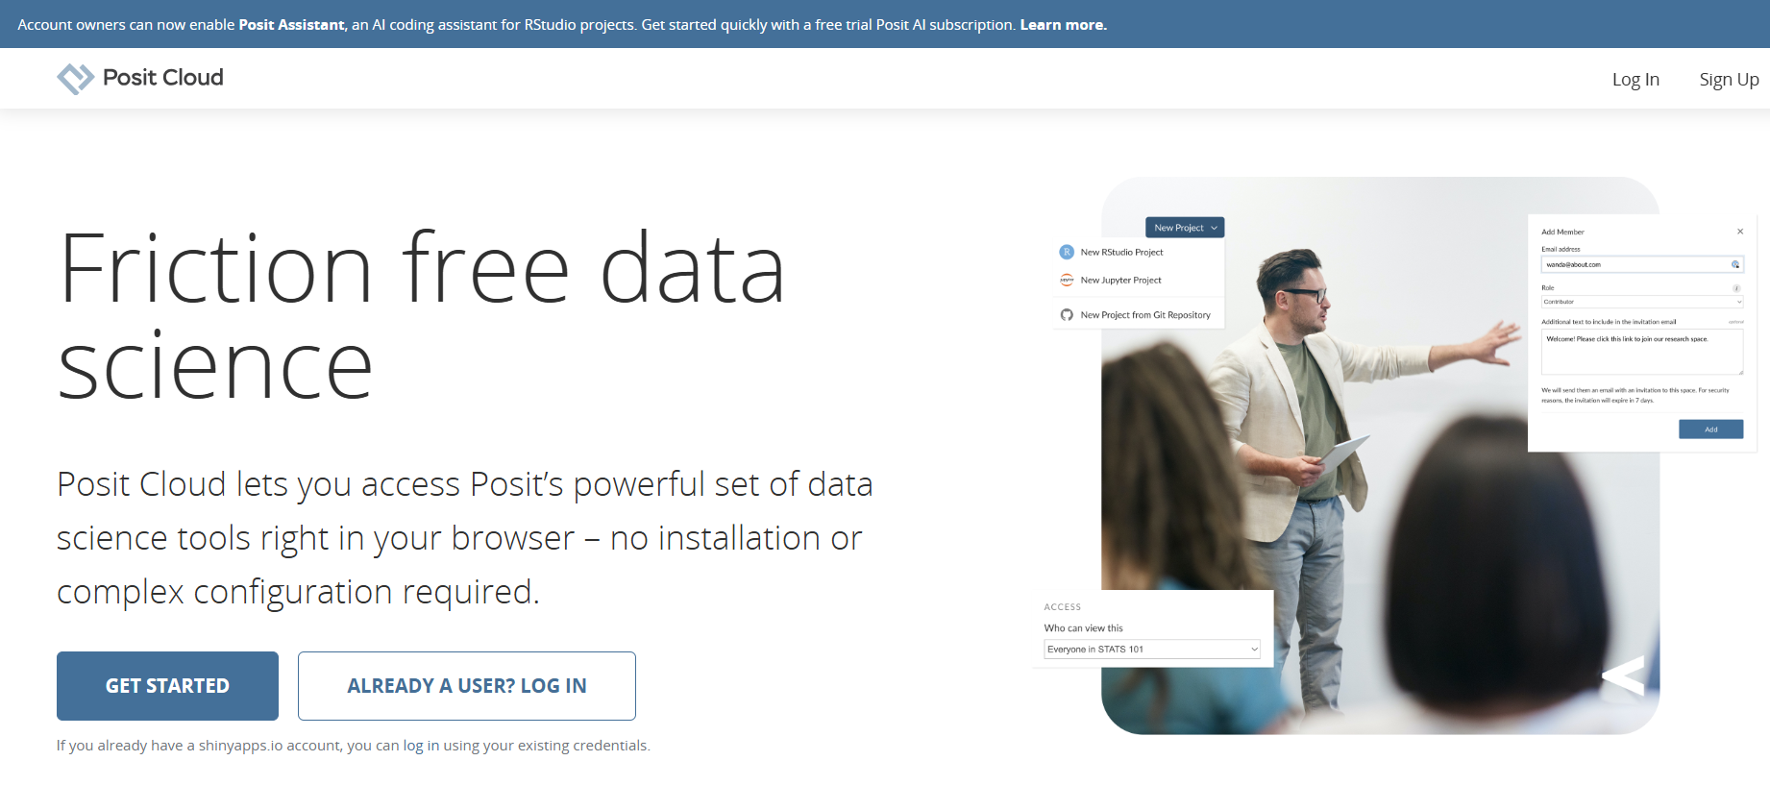
Step 1: Go to posit.cloud

Slide 6
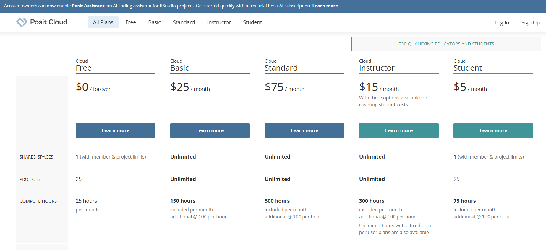

Step 2: Select the free plan

Slide 7
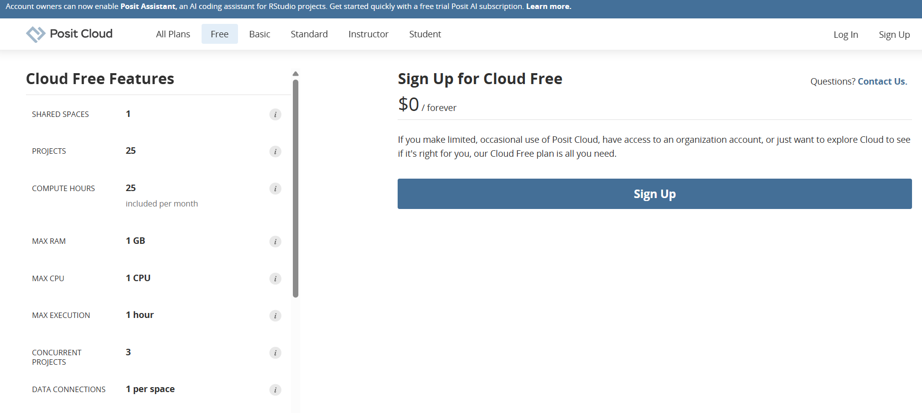
Step 3: Click sign up

Slide 8
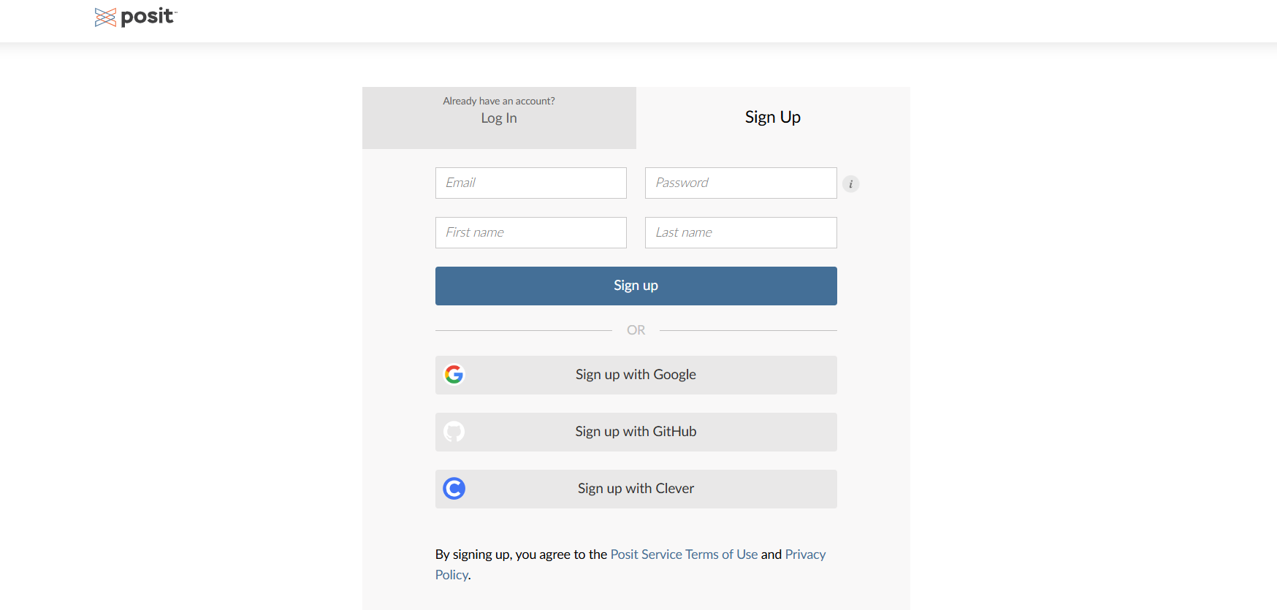
Step 4: Enter your information

Slide 9
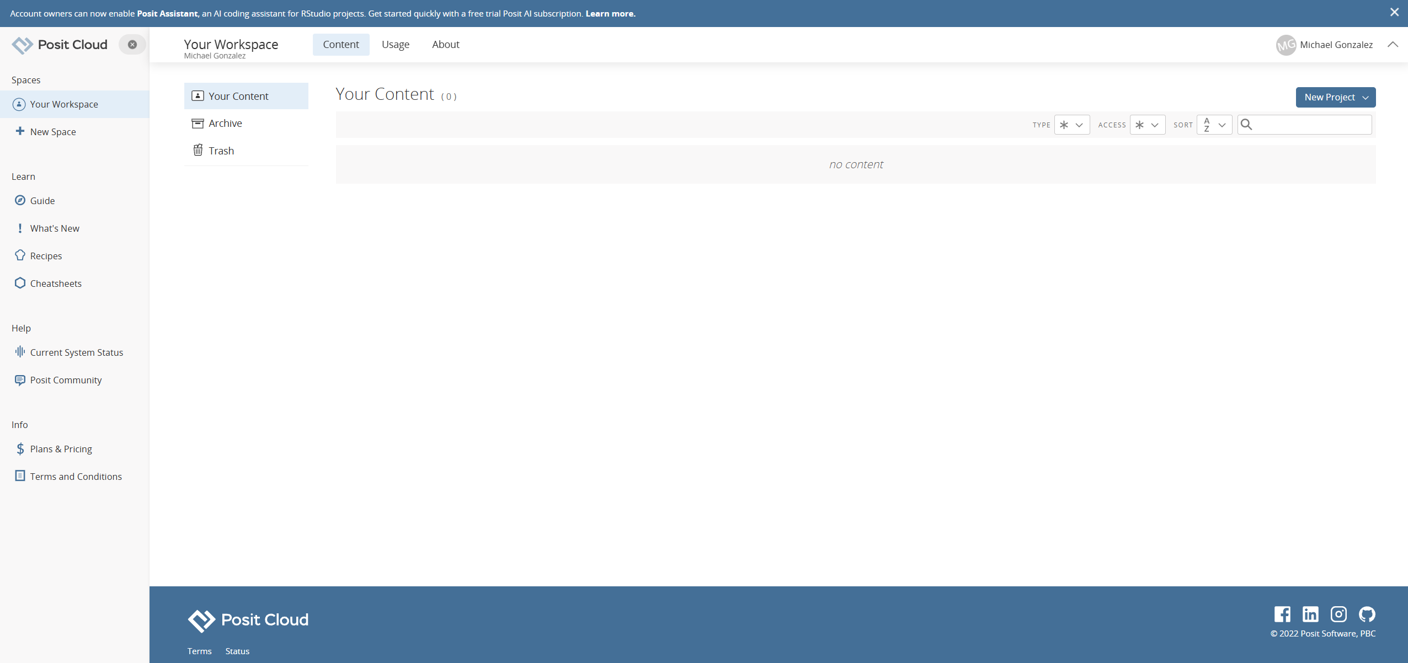

Step 5: Select New Project at top right

Slide 10
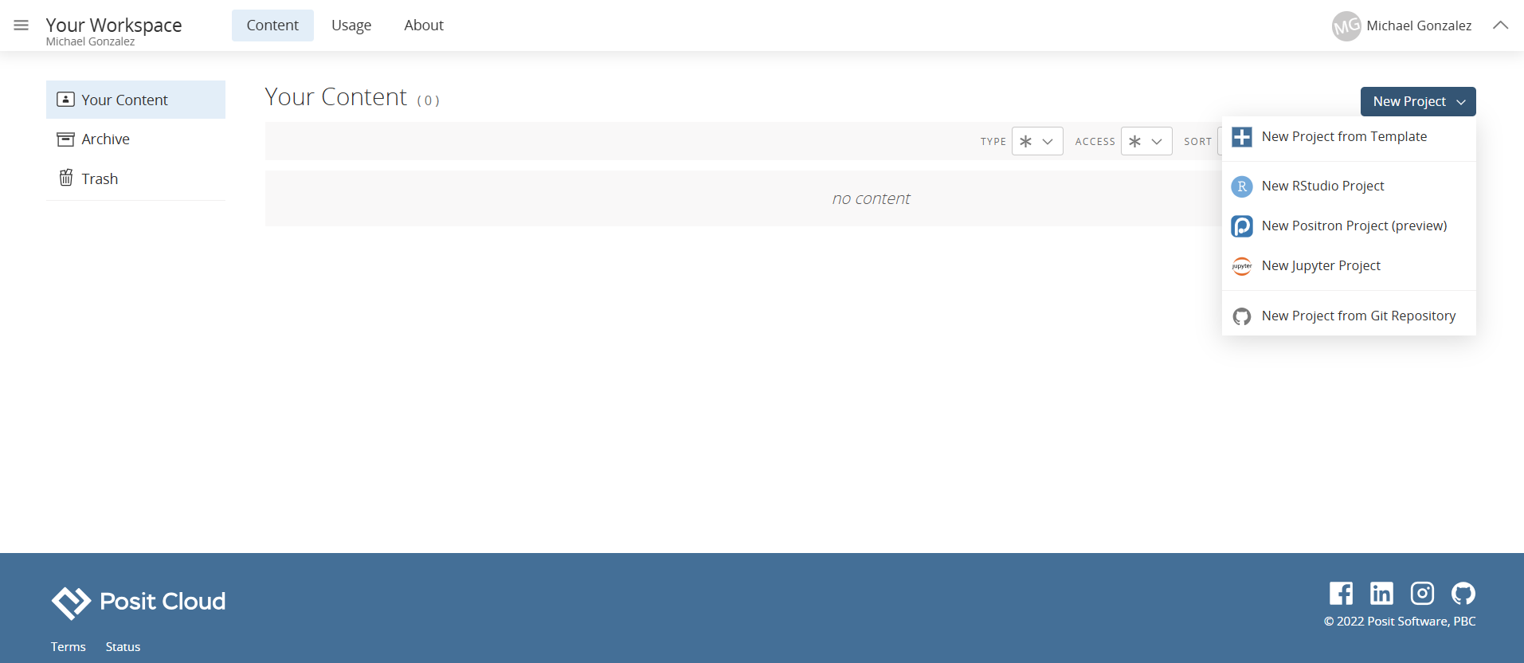
Step 6: Select New RStudio Project

Slide 11
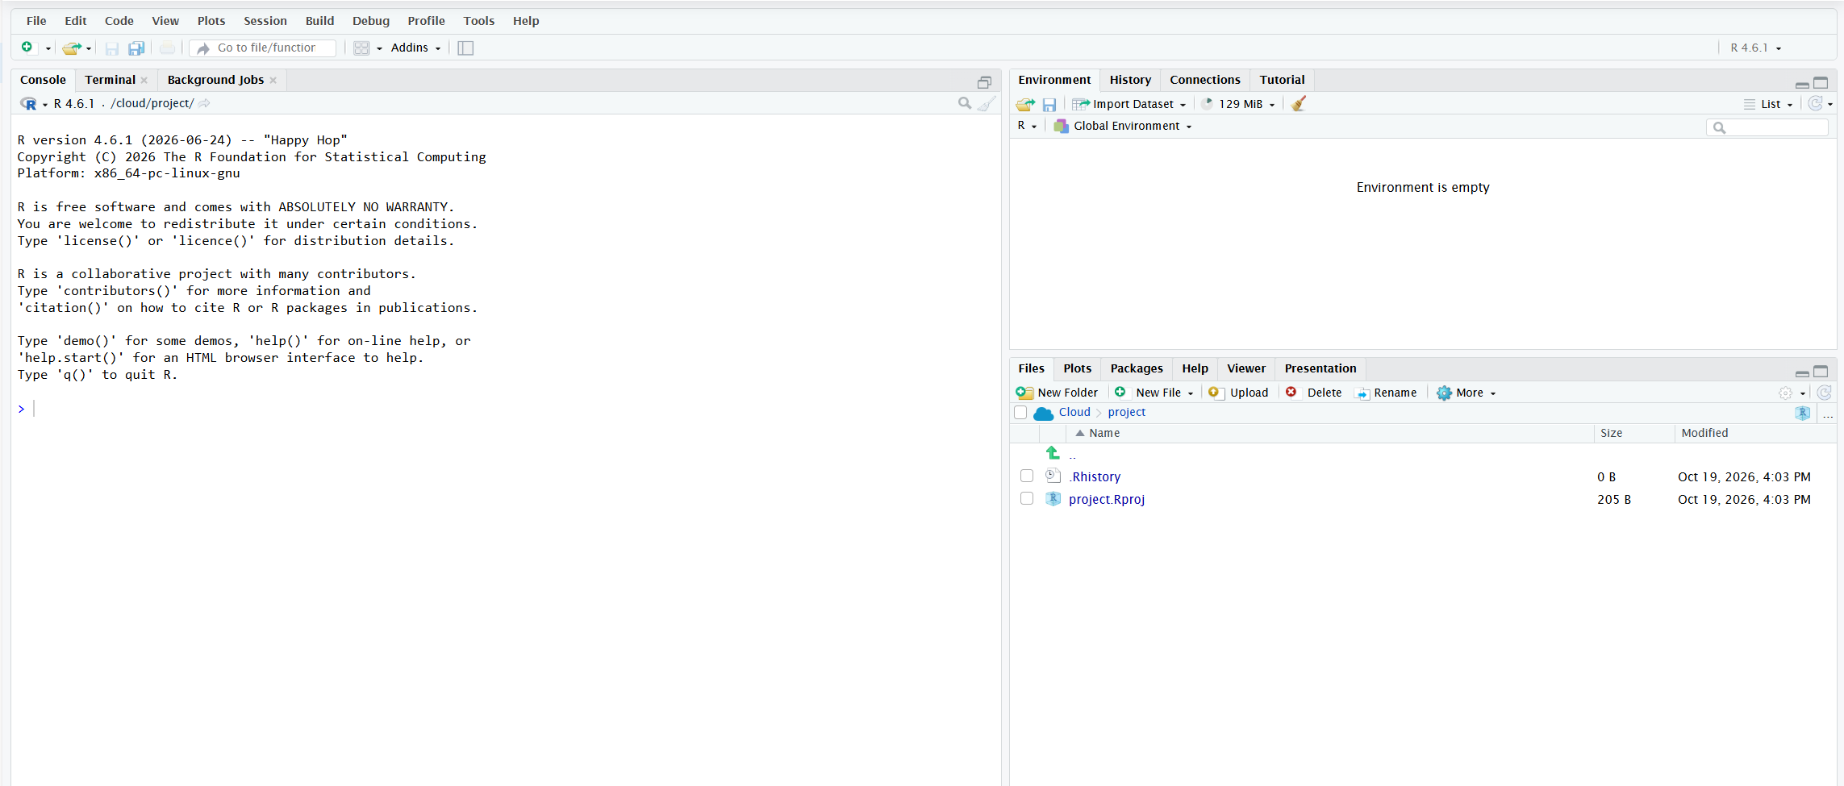
This is the RStudio Environment

Slide 12
Step 7: Hit green plus sign at top left

Slide 13
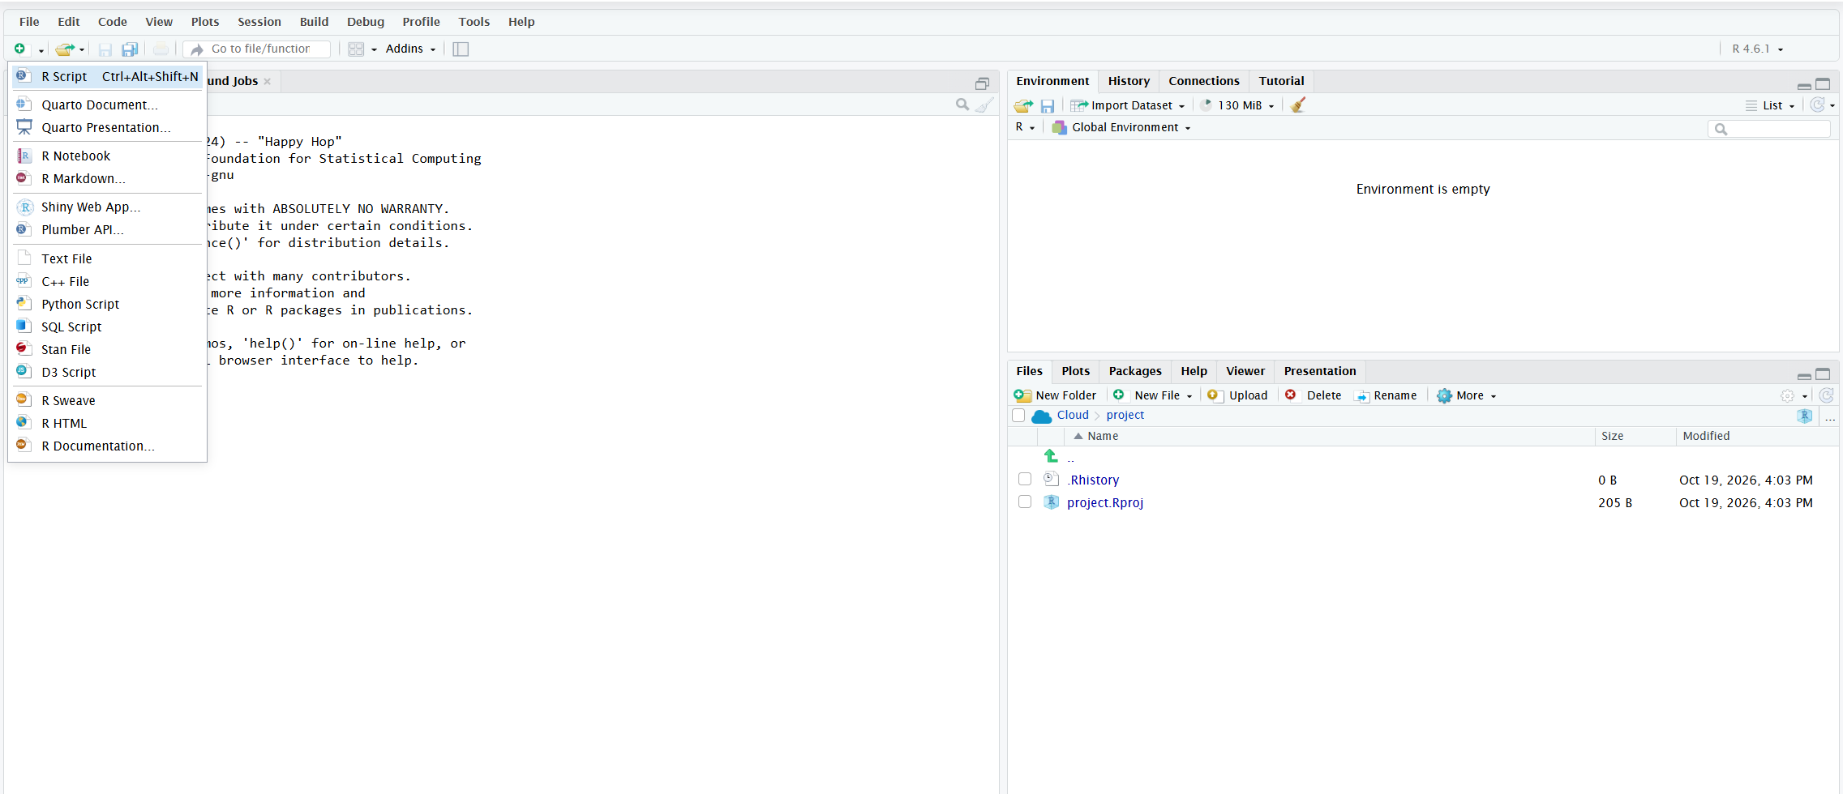
Step 8: Select ‘R Script’

Slide 14
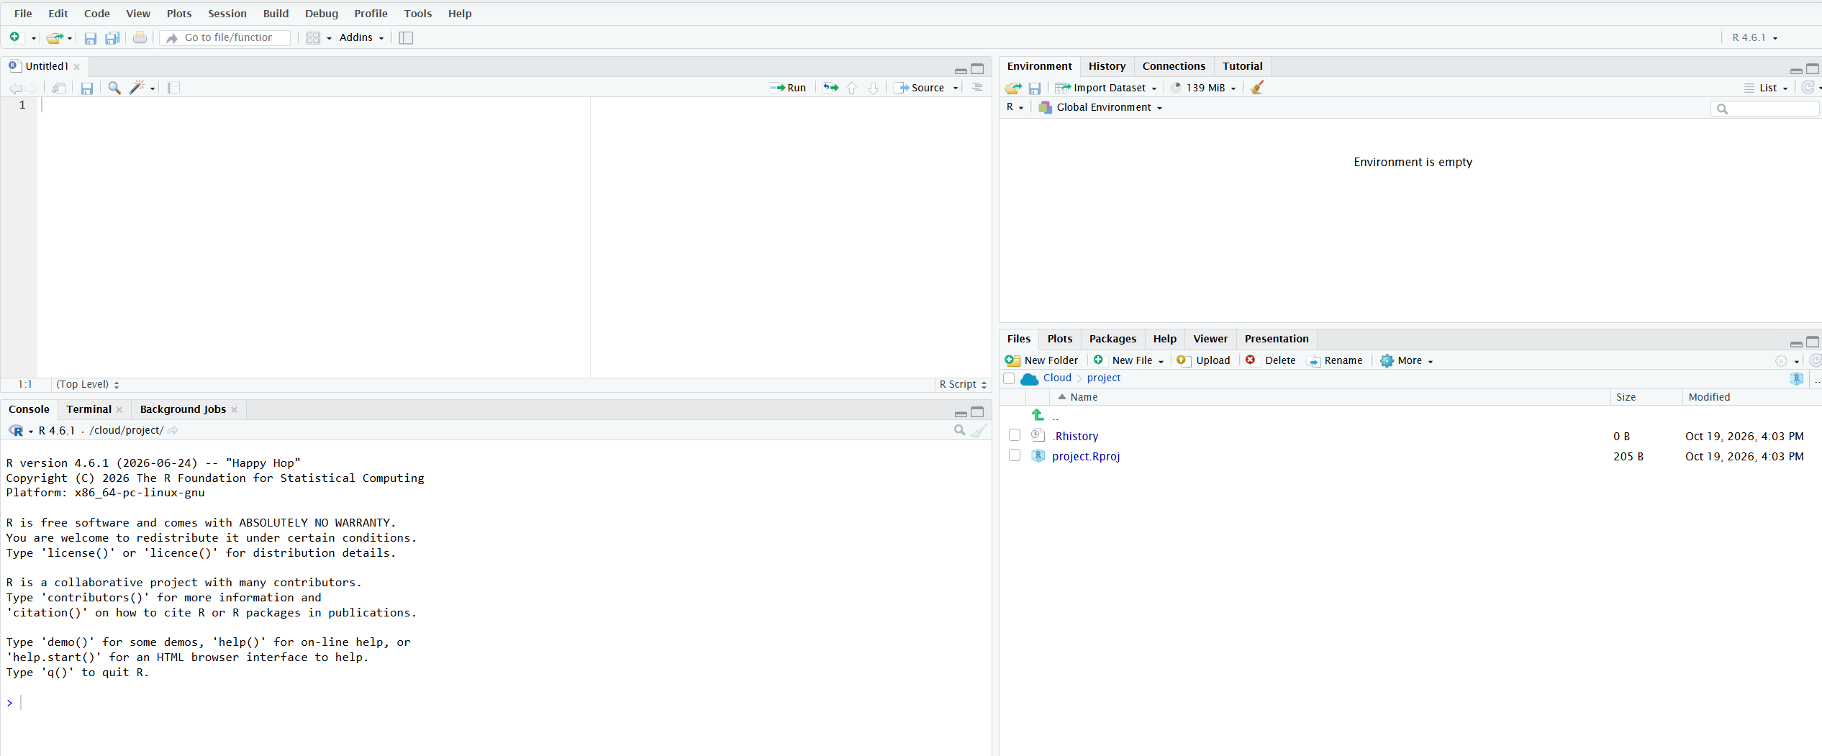
1+1
Source pane

Slide 15
1+1
2
Console pane

Slide 16
Dataset: 2026 Fall Enrollment
Environment pane

Slide 17
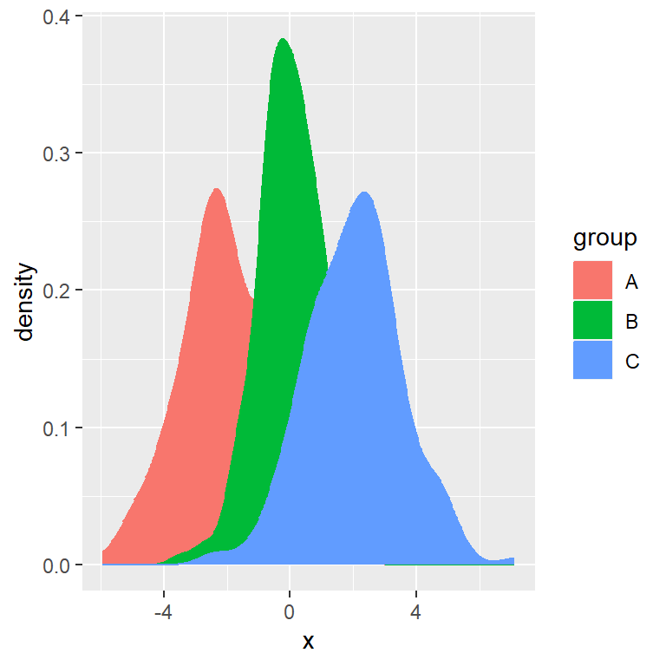
Output pane

Slide 18
Writing R code doesn’t have to be scary
1 #This is a comment
2
3 1+1
4
5

Slide 19
Writing R code doesn’t have to be scary
1 #Get the sum of 1 and 1
2
3 1+1
4
5

Slide 20

Packages give you more tools to use
haven package
tidyverse package

Slide 21
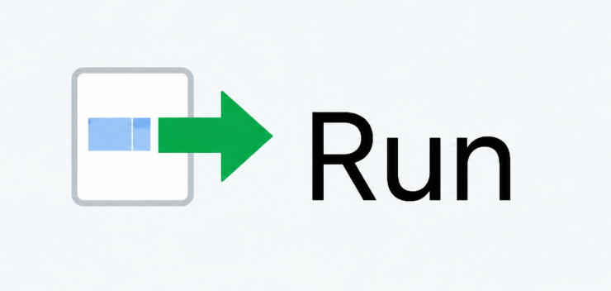
Writing R code doesn’t have to be scary
1 #Install the dplyr package
2
3 install.packages(“dplyr”)
4
5

Slide 22
Writing R code doesn’t have to be scary
1 #Create a new dataset called psych_students.
2 #Keep only students whose major is psychology
3
4 psych_students <- student_data %>%
5 filter(major==“Psychology”)
6

Slide 23
Let’s start writing code!

Slide 24
bit.ly/CAIR2026

Slide 25
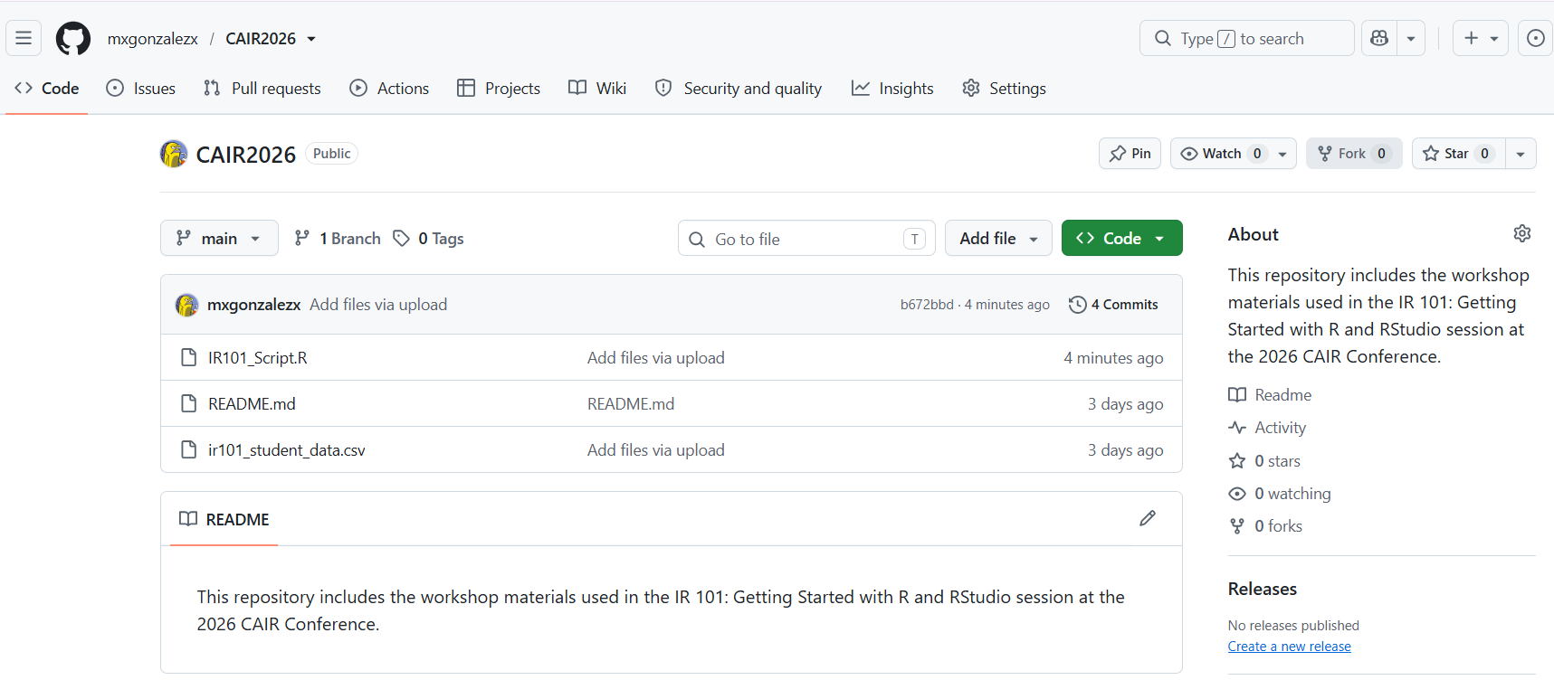
Download IR101_Script.R to your computer

Slide 26
Click Upload and then Choose File
Output pane

Slide 27
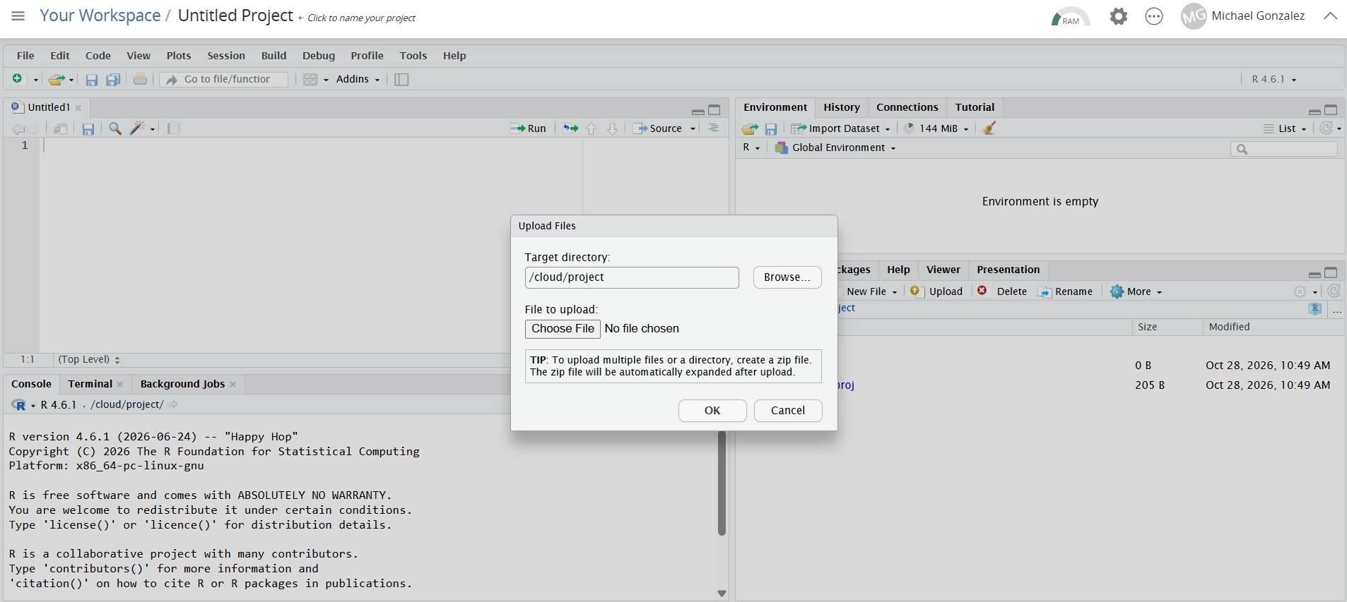
Click Upload and then Choose File

Slide 28
[Switch to RStudio]

Slide 29
